Slide 1



LGE Internal Use Only
'22 Appliance Finder Italy
Fridge Freezers & Washing Machine Spec Checking
2022. 10. 19

Slide 2
Fridge Freezer

Slide 3
Fridge Freezer Structure
0. Intro Motion
Explore our guide step by step!
1. Product type
What type of fridge are you looking for?
2. Product capacity
What capacity do you need?
3. Product size
Which size best fits your space?
4. Ice & Water Dispenser
Do you need a fridge with an Ice & Water Dispenser?
5. Key feature
Which Key feature of a fridge is your priority?
6. Additional features
Which additional features do you want from your fridge?
7. Product colour
Which colour theme matches your interior?

Slide 4
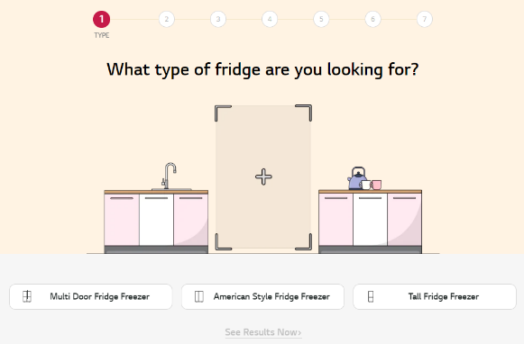
Type
추가 필요 :
Appliance Finder
American Style Fridge Freezers
>
Side-by-Side
Multi Door Fridge Freezers
>
Multidoor
Tall Fridge Freezers
>
Combinati
1
2
3
Doppia Porta
Frigoriferi Maxi Side-by-Side
4
5
*파인더: 제품 타입 추가(2개)

Slide 5
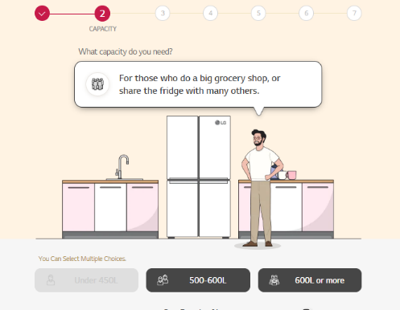
Capacity
추가 필요 :
변경 필요 :
Appliance Finder
Under 400L
>
Meno di 400L
400L~500L
>
Da 400 a 500L
500L~600L
>
Da 500 a 600L
600L or more
>
Piú di 600L
Select All Options
1
2
3
4
*용량 구분 100L 단위로 수정 / 옵션 1개 추가 필요

Slide 6
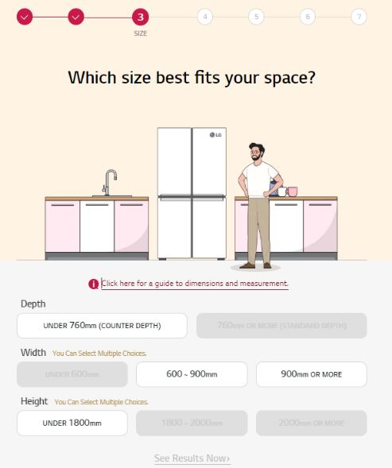
Size
추가 필요 :
Appliance Finder
변경 필요 :
*IT 닷컴: 필터 상 Depth 필터추가 필요 / 기존 옵션 그대로 유지
Under 600mm
Da 600 a 860mm
860mm or more
Select All Options
1
2
3
단위 cm로 통일
Under 1800mm
Da 1800 a 2000mm
2000mm or more
Select All Options
4
5
6

Slide 7
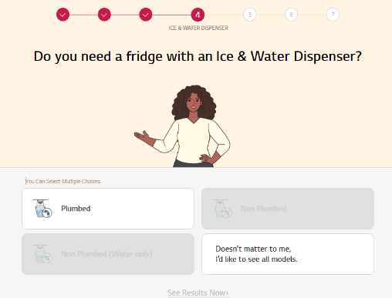
Ice & Water Dispenser
Appliance Finder
Select All Options
*기존 UK와 동일

Slide 8
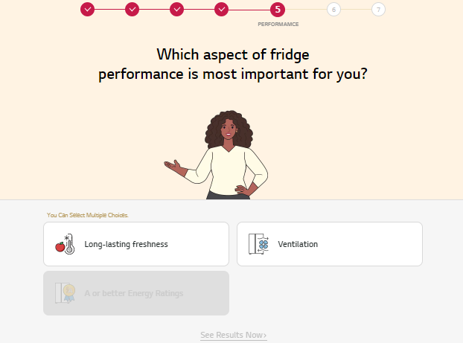
Performance
추가 필요 :
변경 필요 :
Appliance Finder
A or better Energy Ratings
Select All Options
A~C 등급 까지 포함
*기존 UK와 동일

Slide 9
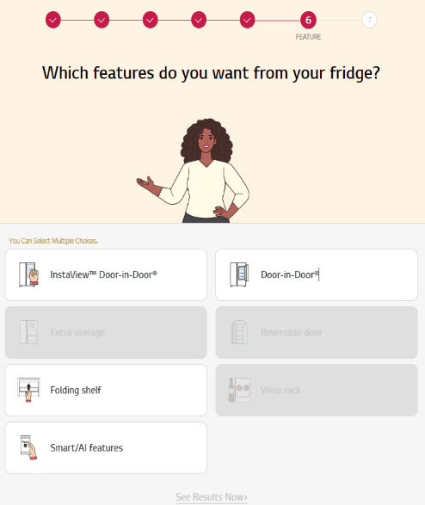
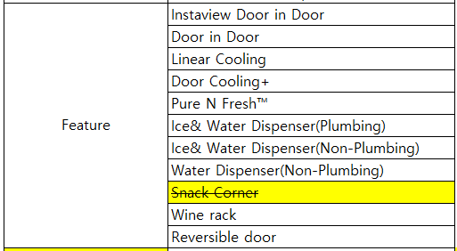
Feature
Appliance Finder
Extra Storage
Reversible Door
Exta Storage 옵션 삭제
Wine Rack
Select All Options

Slide 10
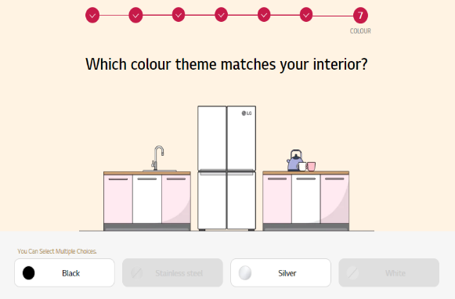
Colour
추가 필요 :
변경 필요 :
Appliance Finder
Stainless Steel
Beige
Select All Options
1
2
3
4
*IT 닷컴: 컬러 필터 추가 필요 (UK기준 화이트 삭제)

